Slide 1


Mentors:
Dr. Chandrakant Guled
Dr. Anagha Khiste
INDIAN INSTITUTE OF INFORMATION TECHNOLOGY, PUNE
Mentors:
Dr. Chandrakant Guled
Dr. Anagha Khiste
AGROHEALTH
MIS | NAME
111916012 | Aryan
111915096 | Punit Pathade
111916034 | Prachhi Sabita Mishra
111915034 | Garvit Rajput

Slide 2
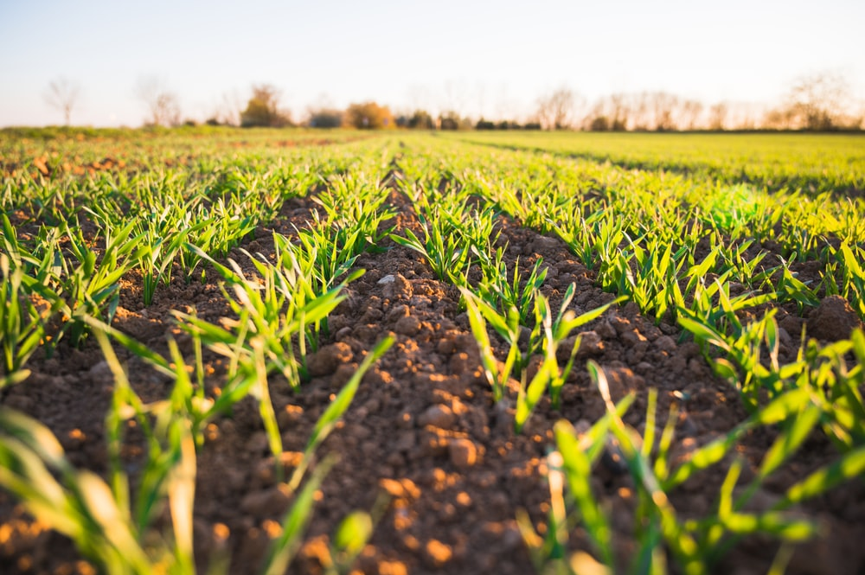
Introduction
As the technology is making advancements in every sector, so we have tried to implement something for agriculture as well as health sector . We have created a machine learning model for crop recommendation, fertilizer prediction, plant disease ,life expectancy prediction and stroke prediction

Slide 3





Table Of Content
About
Project
Literature Survey
Research gaps
Objective
Methodology

Slide 4
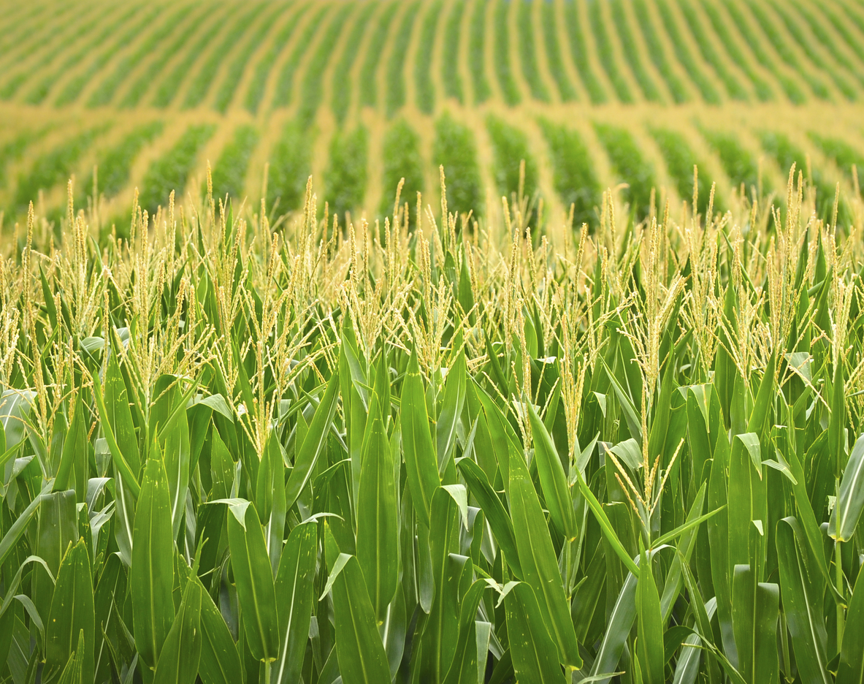
ABOUT THE PROJECT
Web-App
Agriculture and Health sector
Assessment for better crop production and good harvest
Stroke prediction and life expectancy prediction
Machine Learning and Data wrangling
This Photo by Unknown author is licensed under CC BY-NC-ND.

Slide 5

Literature Survey
CSM to Maximize Crop Yield Rate using Machine Learning Technique
Agriculture
Agro Consultant : Intelligent Crop Recommendation
System Using Machine Learning Algorithms
Checking Macro and Micro- nutrients of soil-

Slide 6



01
02
03
Performance and accuracy of CSM
Other natural conditions
Understanding of technology and surveys needed.
Research Gaps

Slide 7





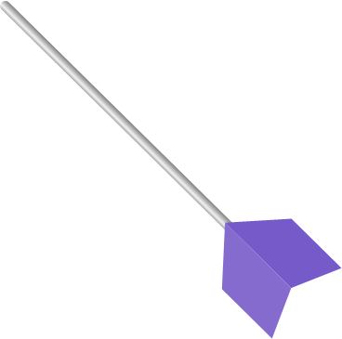

Objective
All Necessary Info
Accessible and free
Fast and UI friendly

Slide 8

Literature Survey
HealthCare

Slide 9
Only the critical factors like immunization, mortality, economic, social and other health related factors are used to predict the output.
Literature Survey
Health Care
Observations in the dataset are based on different countries, so helpful for the countries to decide the areas to give more importance and the one’s contributing to lower value of life expectancy.
Using different ML technique like decision tree, naive bayes,etc they are able to secure a accuracy of 80% only.
Authors have used a combination of algorithm and machine learning technique. But the CHS Dataset taken for this work had a smaller number of input parameters.

Slide 10
01
02
03
Stroke prediction is limited to only textual data, using Brain CT Scan it can be more efficient.
For a very large area, used set of parameters can vary largely which could adversely affect the predicted output from the model
Healthcare Sector is one of the primary concern and crucial sectors, so the model's accuracy should be precise.
Research Gaps

Slide 11
Objective
Focusing on real life
Predicting life Expectancy
Stroke prediction

Slide 12





Methodology
Data Preprocessing
Handling missing values
Handling imbalance data
Label encoding
Data Collection
Model Building
Testing
ML Algorithms

Slide 13
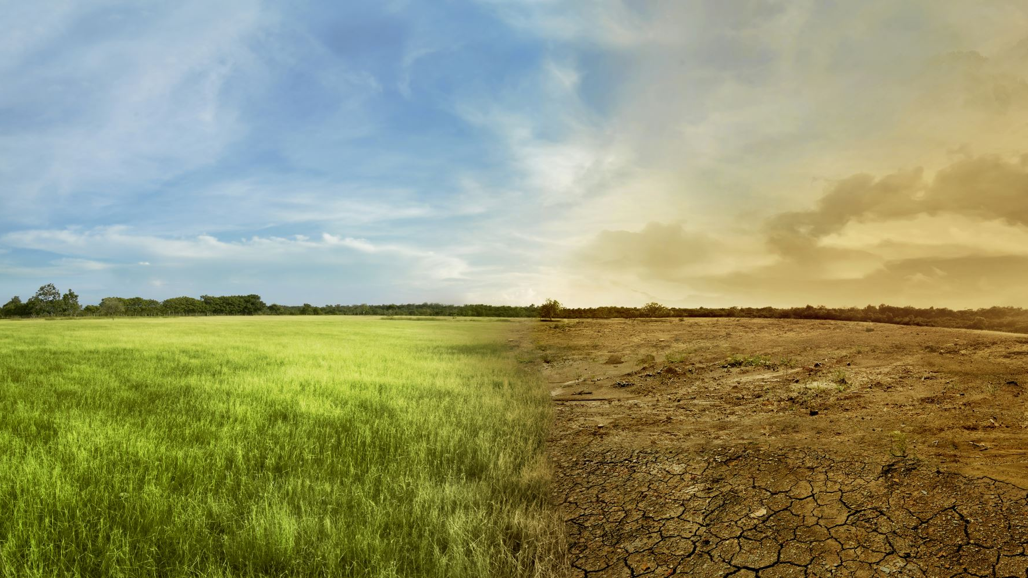


Answering possible questions
Why combine two fields of health and agriculture?
Eat good, stay good.
An new idea worth a try
Target audience is rural people
Which ML algo we have used?
We have used Random Forest for all the models
Why Random Forest is used?
We made the models using five ML algos. Out of which Random forest gave the best results.

Slide 14
SNEAK PEEK

Slide 15
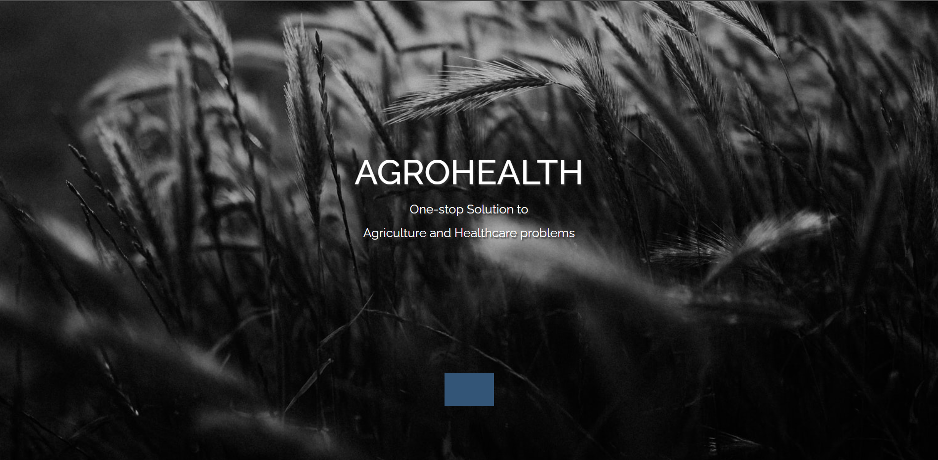

Slide 16
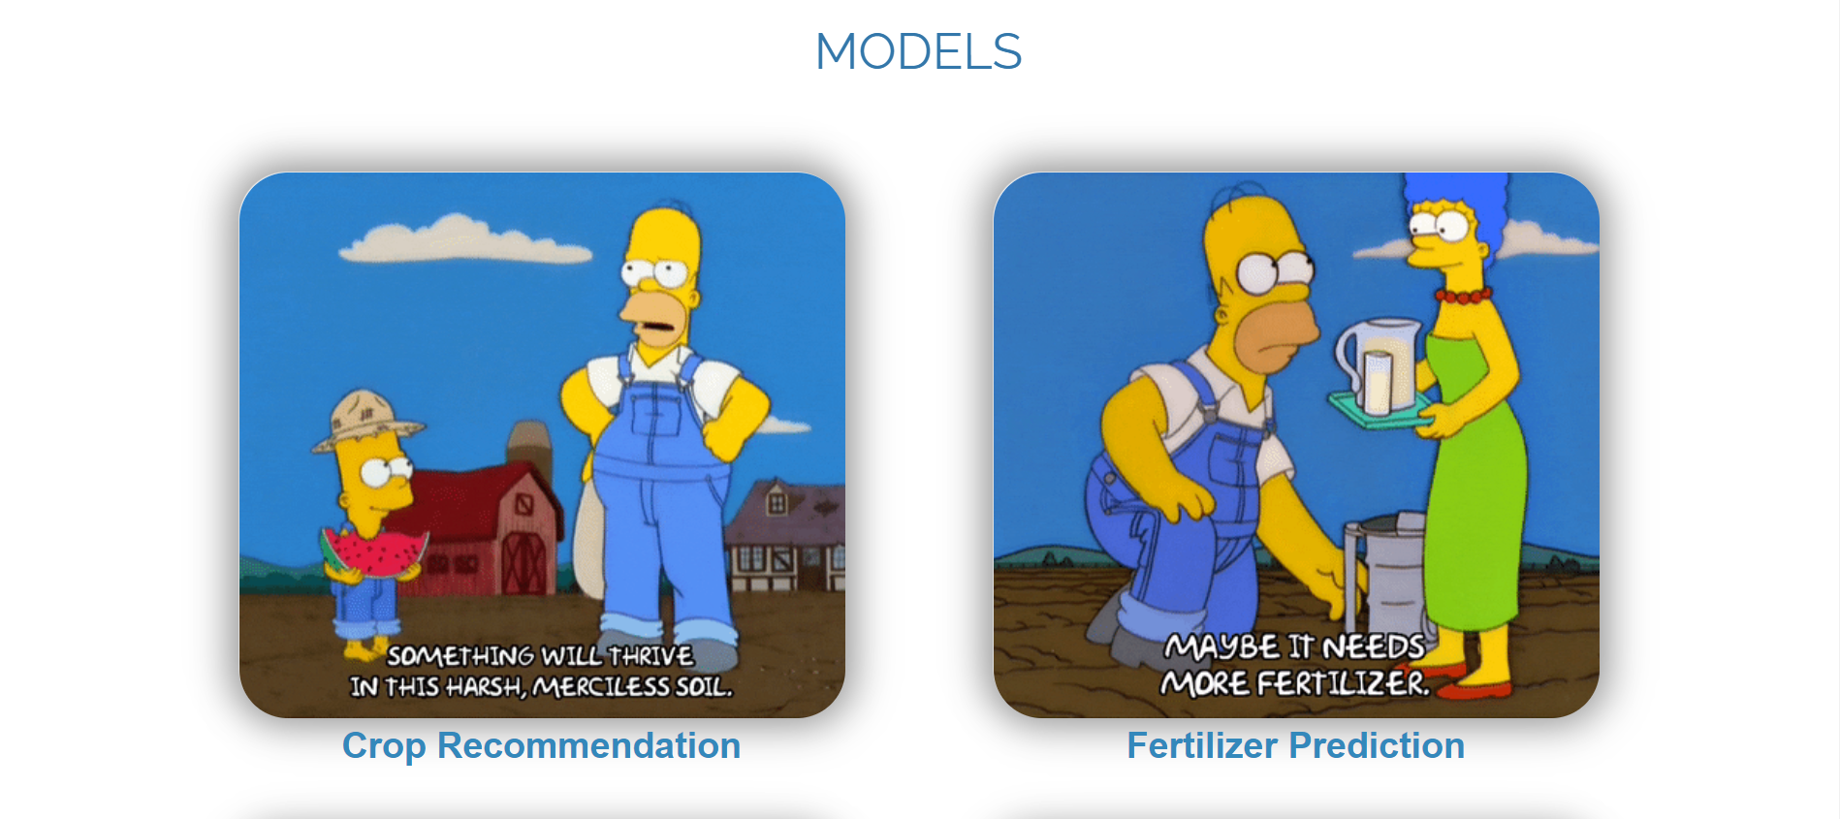
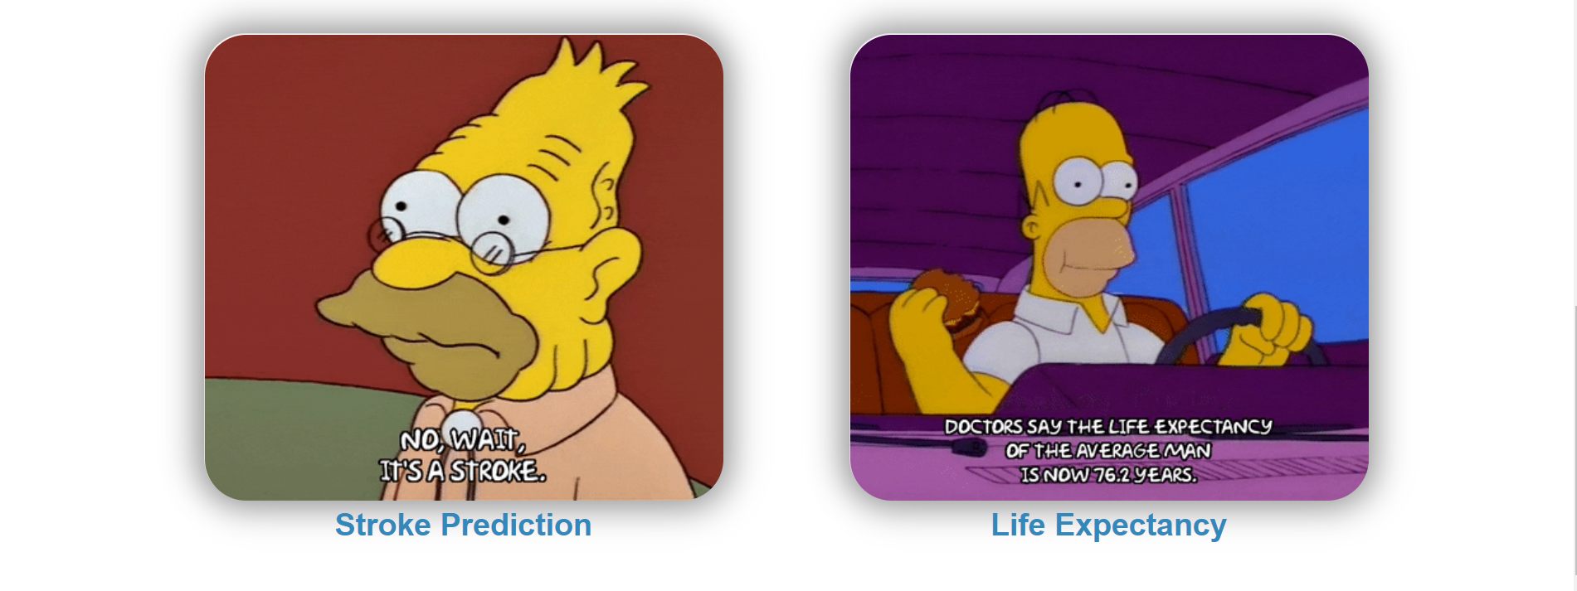

Slide 17
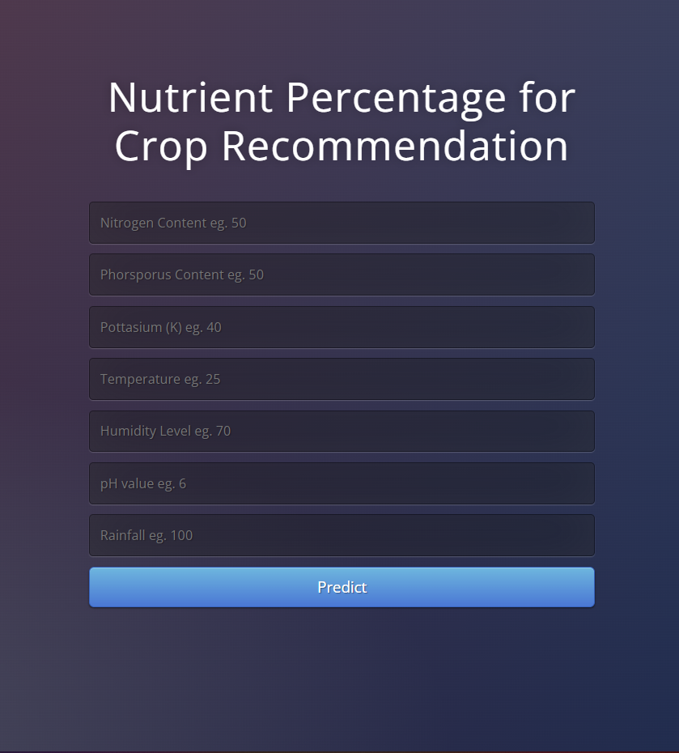
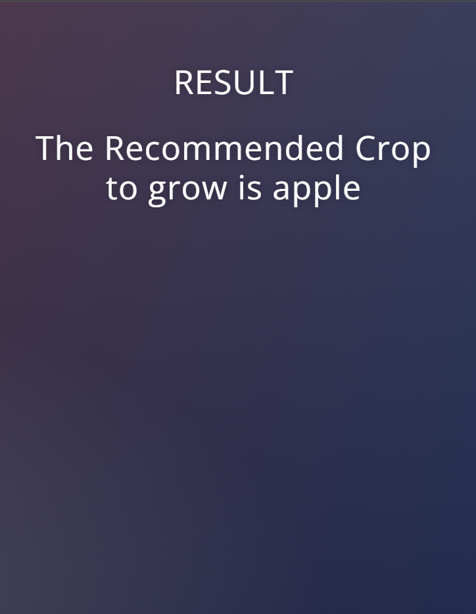

Slide 18
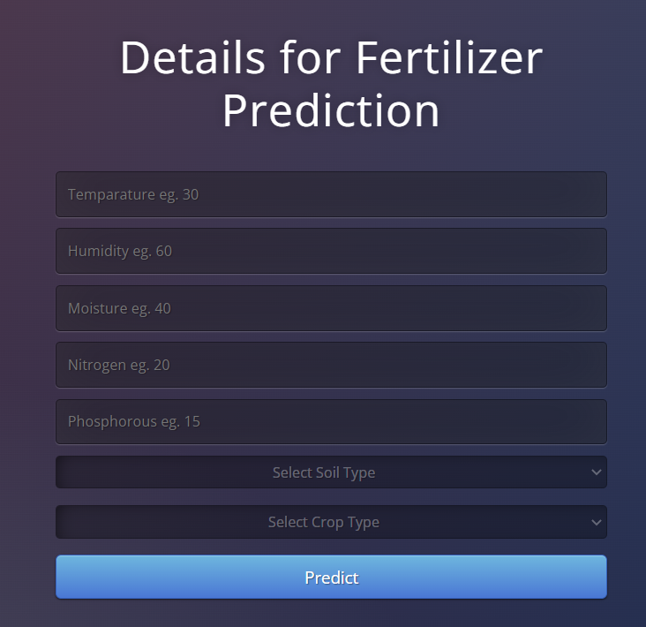
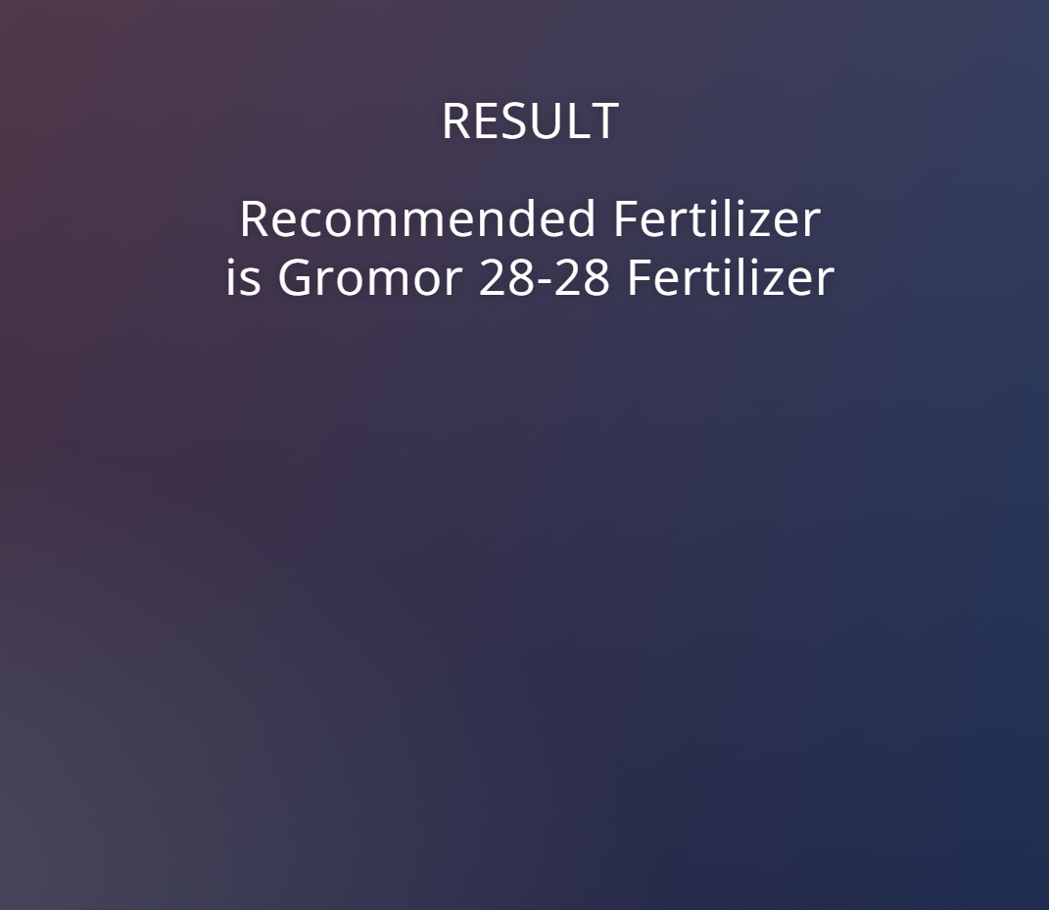

Slide 19
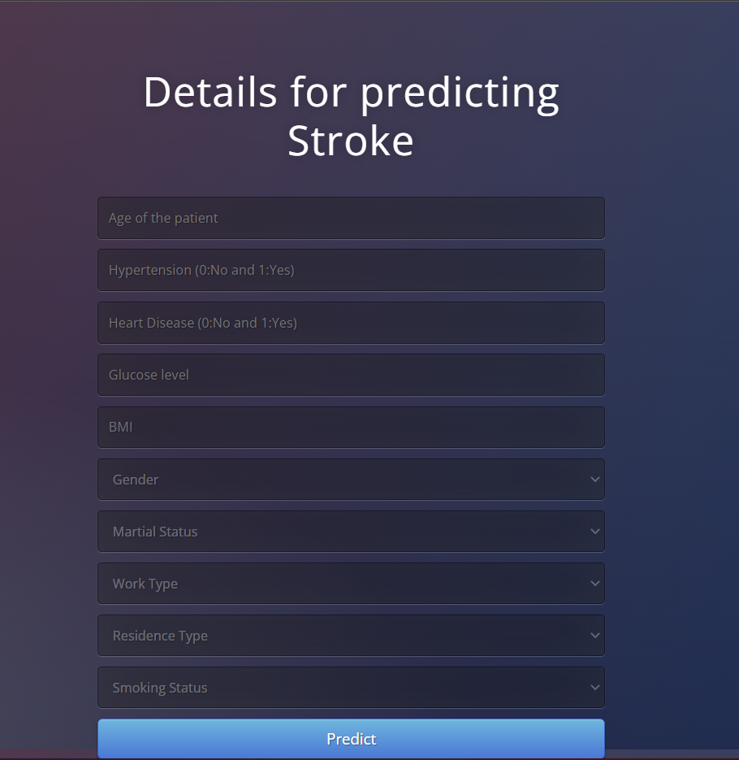
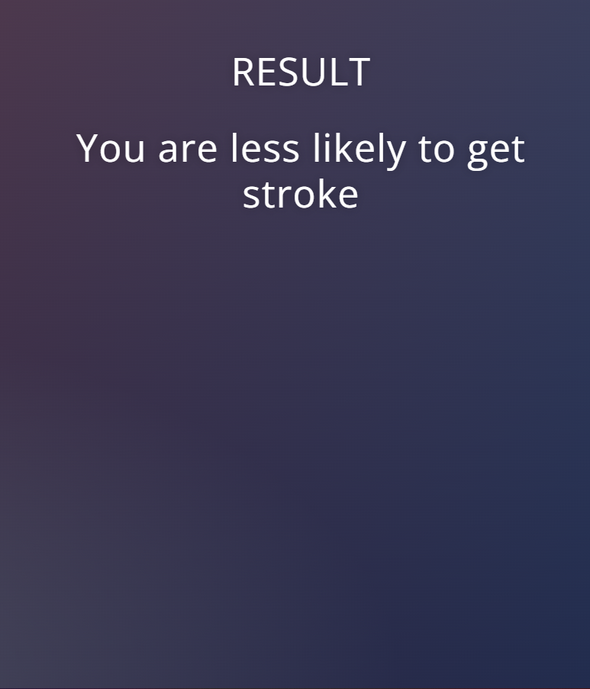

Slide 20
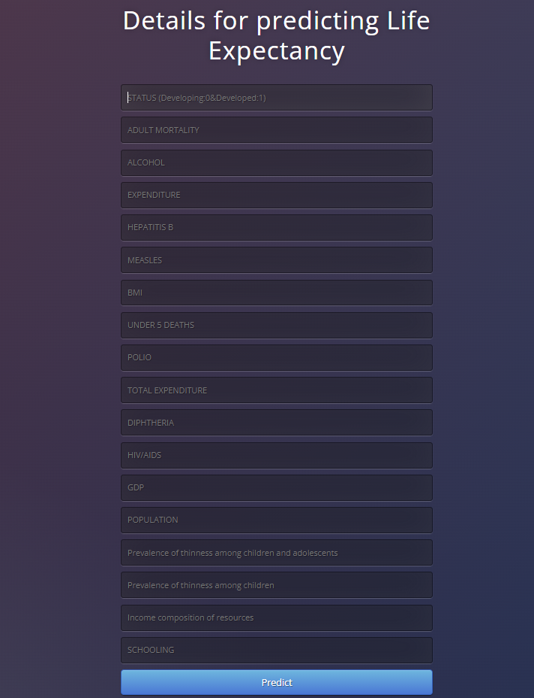
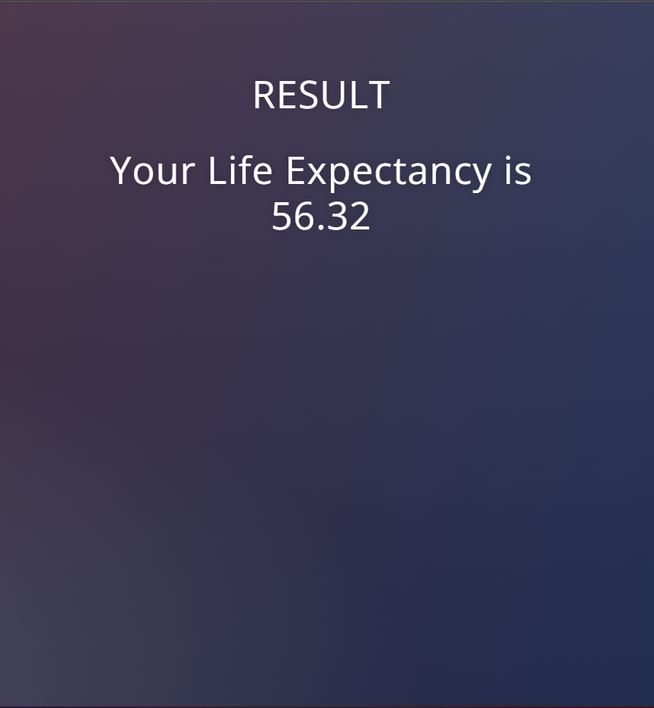

Slide 21





Inclusion of IT into Health sector
Scaling, Outreach and Awareness
Practical implementation of Data science
Early Alerts
Keeping it simple

Slide 22
References
Rakesh Kumar, M.P. Singh, Prabhat Kumar and J.P. Singh, "Crop Selection Method to maximize crop yield rate using machine learning technique".
Zeel Doshi, Subhash Nadkarni, Rashi Agrawal, Prof. Neepa Shah, "Agro Consultant: Intelligent Crop Recommendation System Using Machine Learning Algorithms".
“Analyzing the Performance of Stroke Prediction using ML Classification Algorithms “, a journal by Gangavarapu Sailasya , Gorli L Aruna Kumari
https://www.geeksforgeeks.org/machine-learning/
Published by IEEE Vikram Bali,Deepti Aggarwal, Sumit Singh, Arpit Shukla “Life Expectancy: Prediction & Analysis using ML”

